Slide 1
Boosting Algorithm
Regression

Slide 2
What is Boosting Algorithm?
Boosting is an ensemble modeling technique that attempts to build a strong classifier from the number of weak classifiers. It is done by building a model by using weak models in series.

Slide 3
Types of Boosting Algorithm:
Ada Boost
Extreme Gradient Boost
Light GBM

Slide 4
Ada Boost
AdaBoost algorithm falls under ensemble boosting techniques.
Multiple weak learners are allowed to learn on training data
Combining these models to generate a meta-model, this meta-model aims to resolve the errors as predicted by the individual weak learners.

Slide 5
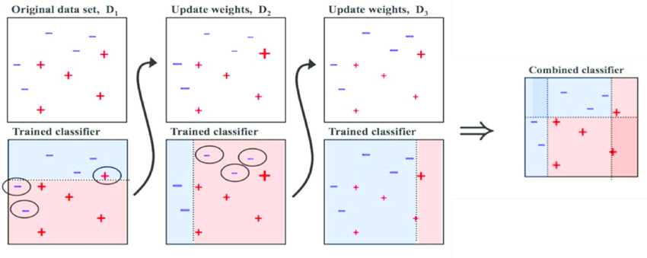
Ada Boost

Slide 6
Working Principle
The principle behind ada boosting algorithms is that we first build a model on the training dataset and then build a second model to rectify the errors present in the first model. This procedure is continued until and unless the errors are minimized and the dataset is predicted correctly.

Slide 7
Advantages of AdaBoost
Can handle binary and multi-class classification problems.
Can handle noisy data and outliers.
Has a high degree of interpretability, since it relies on simple weak classifiers that can be easily understood.
Often results in high accuracy and outperforms other algorithms in many scenarios.

Slide 8
Disadvantages of AdaBoost
Sensitive to noisy data and outliers that are not properly preprocessed.
Can be computationally expensive, especially with large datasets.
Can lead to overfitting if the weak classifiers are too complex or if the number of boosting iterations is too high.
Requires careful parameter tuning to achieve optimal performance.

Slide 9
Applications of AdaBoost
AdaBoost is widely used in applications such as face detection, object recognition, and text classification. It is particularly effective when the data is noisy or when there are many irrelevant features. AdaBoost can also be used in other areas of machine learning, such as regression and clustering.

Slide 10
XG Boosting
XGBoost is a powerful approach for building supervised regression models. The validity of this statement can be inferred by knowing about its (XGBoost) objective function and base learners. The objective function contains loss function and a regularization term. It tells about the difference between actual values and predicted values

Slide 11
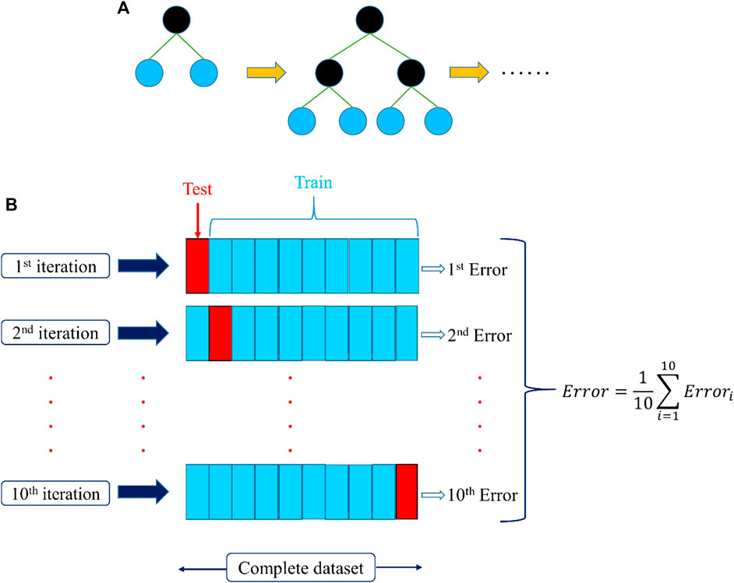
XG Boosting

Slide 12
Working Principle
XGBoost builds a predictive model by combining the predictions of multiple individual models, often decision trees, in an iterative manner. The algorithm works by sequentially adding weak learners to the ensemble, with each new learner focusing on correcting the errors made by the existing ones.

Slide 13
XG Boosting
Advantages: Effective with large data sets. Tree algorithms such as XGBoost and Random Forest do not need normalized features and work well if the data is nonlinear, non-monotonic, or with segregated clusters.
Disadvantages: Tree algorithms such as XGBoost and Random Forest can over-fit the data, especially if the trees are too deep with noisy data.

Slide 14
Applications of XG Boosting
High Accuracy: XGBoost's gradient boosting framework improves model accuracy by minimizing the residual errors of prior models, making it powerful for complex regression problems.
Handling Missing Data: It can handle missing data internally, making it robust in real-world applications where missing values are common.
Speed and Efficiency: XGBoost is optimized for speed, handling large datasets efficiently due to its parallel processing capabilities.
Feature Importance: It provides insights into feature importance, helping in understanding which variables most influence the prediction.

Slide 15
LG Boosting
LightGBM is an ensemble learning framework, specifically a gradient boosting method, which constructs a strong learner by sequentially adding weak learners in a gradient descent manner. It optimizes memory usage and training time with techniques like Gradient-based One-Side Sampling (GOSS).

Slide 16
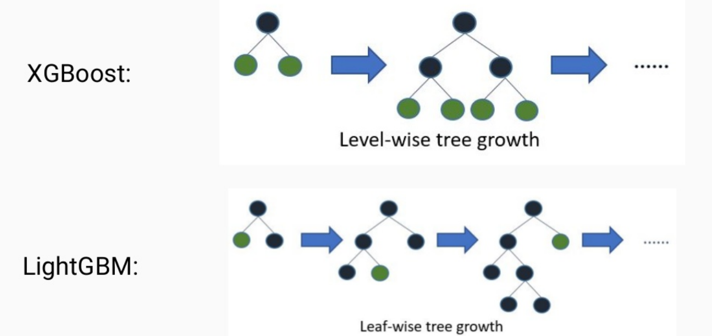
LG Boosting

Slide 17
Working Principle
A histogram of the distribution is used by LightGBM to bucket data into bins. Instead of using every data point, the bins are used to iterate, calculate the gain, and divide the data.

Slide 18
Advantages of LG Boosting
Lower memory usage: Replaces continuous values to discrete bins which results in lower memory usage.
Better accuracy than any other boosting algorithm: It produces much more complex trees by following leaf wise split approach rather than a level-wise approach which is the main factor in achieving higher accuracy.

Slide 19
Disadvantages of LG Boosting
Overfitting: Light GBM split the tree leaf-wise which can lead to overfitting as it produces much complex trees.
Compatibility with Datasets: Light GBM is sensitive to overfitting and thus can easily overfit small data.

Slide 20
Applications of LG Boosting
Financial Modeling: Predicting stock prices or credit scoring.
Real Estate: Estimating property prices based on various factors.
Healthcare: Predicting patient outcomes or healthcare costs.
Energy: Forecasting energy consumption.

